Slide 1
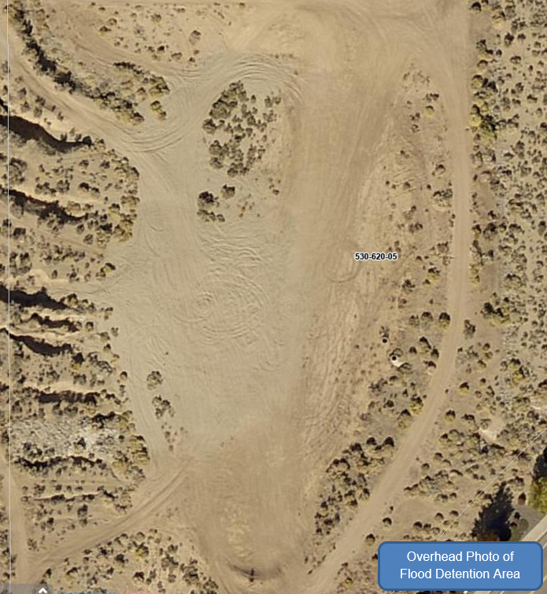
SPECIAL USE PERMIT CASE NO: WSUP21-0027 (Eagle Canyon North – Permanent Flood Control)
Washoe County Board of Adjustment
November 4, 2021

Slide 2
Request
Special use permit to allow major grading of approximately 75,360 square feet of disturbance and excavation and exportation of approximately 5,490 cubic yards of earthen material for the purpose of improvement and expansion of existing flood control facilities in Spanish Springs.

Slide 3
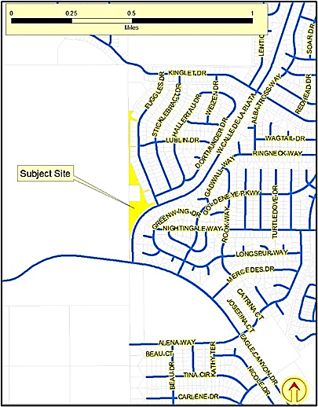
Vicinity Map

Slide 4
Site Plan

Slide 5
Evaluation
Major grading improves an existing flood control facility
Proposed by the homeowner's association to enhance the protection of the existing homes
Expands a drainage channel and deepens an existing retention basin
Benefits of increased control of stormwater run off are obvious
Few negative impacts
Negative impacts resulting from the public access to, and misuse of, the flood control facilities
Facilities are being utilized by OHVs which substantially degrades facility

Slide 6
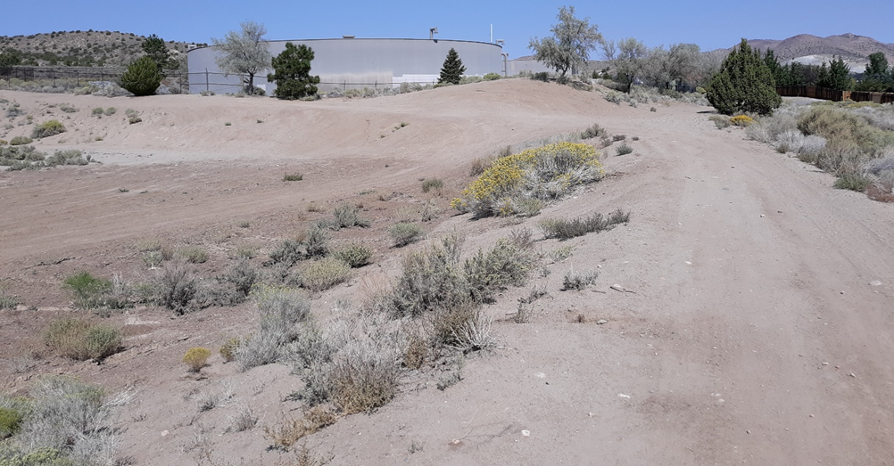
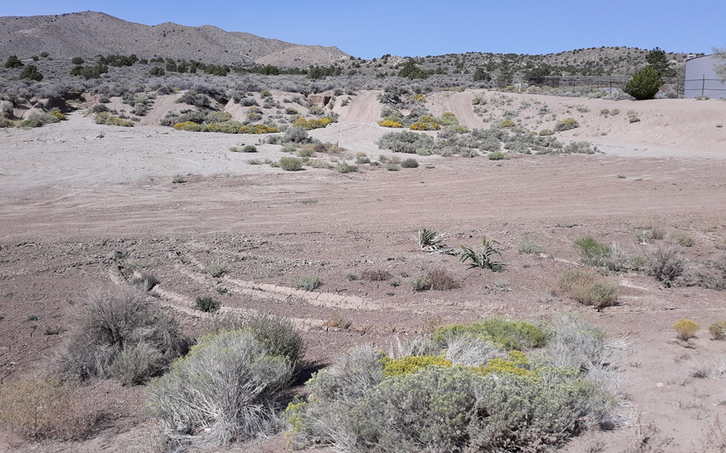
Site Photos

Slide 7
Proposed Conditions of Approval
Inhibit access to site (fence and boulders)
Landscape (general Code requirement)
Limit working hours
7AM and 7PM Monday through Friday,
9AM and 5PM on Saturday
No construction on Sunday

Slide 8
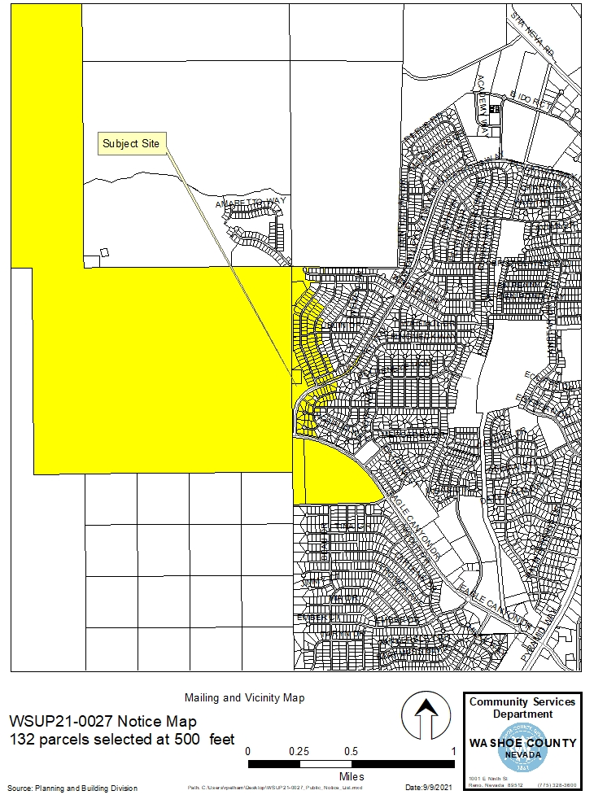
Public Notice
Notice sent to 132 affected property owners

Slide 9
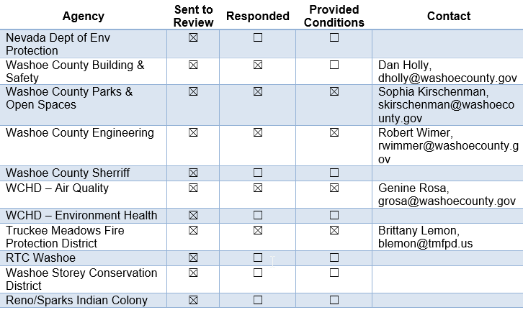
Reviewing Agencies

Slide 10
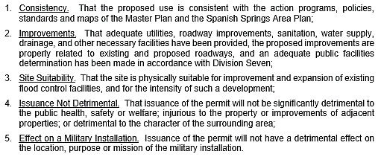
Special Use Permit Findings
Staff Comments on findings are found on pages 10 and 11 of the staff report.

Slide 11
Recommendation
After a thorough analysis and review, Special Use Permit Case Number WSUP21-0027 is being recommended for approval with conditions.

Slide 12
Possible Motion
I move that, after giving reasoned consideration to the information contained in the staff report and information received during the public hearing, the Washoe County Board of Adjustment approve with conditions Special Use Permit Case Number WSUP21-0027 for Equus Management Group, with the conditions included as Exhibit A to this matter, having made all five findings in accordance with Washoe County Code Section 110.810.30.

